Slide 1

The Importance of Belonging in Computer Science
Vidya Gaddy
Computer Science Department
Colorado State University

Slide 2
Current Progress: Research Questions
Does a familial background or personal connection with computer science and the technology community (a sense of belonging) influence a students decision to take computer science courses?
Can a virtual environment temporarily influence a persons sense of belonging in computer science enough to alter their decision to take a computer science course?

Slide 3
Current Progress: Hypothesis
Computer science graduate students who have been exposed to a virtual environment and audio cues that prime them to believe they have no familial or personal connection to computer science will choose not to take a computer science course presented in the virtual environment.

Slide 4
Current Progress: Relevant Literature
Current perspectives on significance of belonging when choosing a major
Alignment of Goals and Perceptions of Computing Predicts Students' Sense of Belonging in Computing
Lewis, Colleen and Bruno, Paul and Raygoza, Jonathan and Wang, Julia
Proceedings of the 2019 ACM Conference on International Computing Education Research
"I Don't Code All Day": Fitting in Computer Science When the Stereotypes Don't Fit
Lewis, Colleen M. and Anderson, Ruth E. and Yasuhara, Ken
Proceedings of the 2016 ACM Conference on International Computing Education Research
A Question of Belonging: Race, Social Fit, and Achievement
Walton, G. M., & Cohen, G. L.
Journal of Personality and Social Psychology (2007)

Slide 5
Current Progress: Relevant Literature
Current Perspectives on inciting a sense of belonging
Positionality and Belonging: Analyzing an Informally Situated and Culturally Responsive Computer Science Program
Diane Codding, Chrystalla Mouza, Rosalie Rolón-Dow, and Lori Pollock
Proceedings of FabLearn 2019 (FL2019)
Applying Self-Determination Theory towards Motivating Young Women in Computer Science
Allison Mishkin
Proceedings of the 50th ACM Technical Symposium on Computer Science Education (SIGCSE '19)
Formal Research Experiences for First Year Students: A Key to Greater Diversity in Computing?
Jane G. Stout, N. Burçin Tamer, and Christine J. Alvarado
Proceedings of the 49th ACM Technical Symposium on Computer Science Education (SIGCSE '18)

Slide 6
Current Progress: Relevant Literature
Current perspectives on virtual reality being used for affective manipulation
Immersive Interfaces for Engagement and Learning: Cognitive Implications
Jérôme Dinet and Munéo Kitajima
Proceedings of the Virtual Reality International Conference - Laval Virtual (VRIC '18)
Building long-term empathy: A large-scale comparison of traditional and virtual reality perspective-taking
Fernanda Herrera,Jeremy Bailenson,Erika Weisz,Elise Ogle,Jamil Zaki
PLoS ONE 13(10) (2018)
Being them: presence of using non-human avatars in immersive virtual environment
Dong-Yong Lee, Yong-Hun Cho, and In-Kwon Lee
Proceedings of the 24th ACM Symposium on Virtual Reality Software and Technology (VRST '18)
The Impact of Avatar Personalization and Immersion on Virtual Body Ownership, Presence, and Emotional Response
T. Waltemate, D. Gall, D. Roth, M. Botsch and M. E. Latoschik
IEEE Transactions on Visualization and Computer Graphics (2018)

Slide 7
Current Progress: Tools
Unity Engine
Develop virtual environment
Oculus Rift
Visualize virtual environment
Google Forms
Collect initial background data from participants

Slide 8
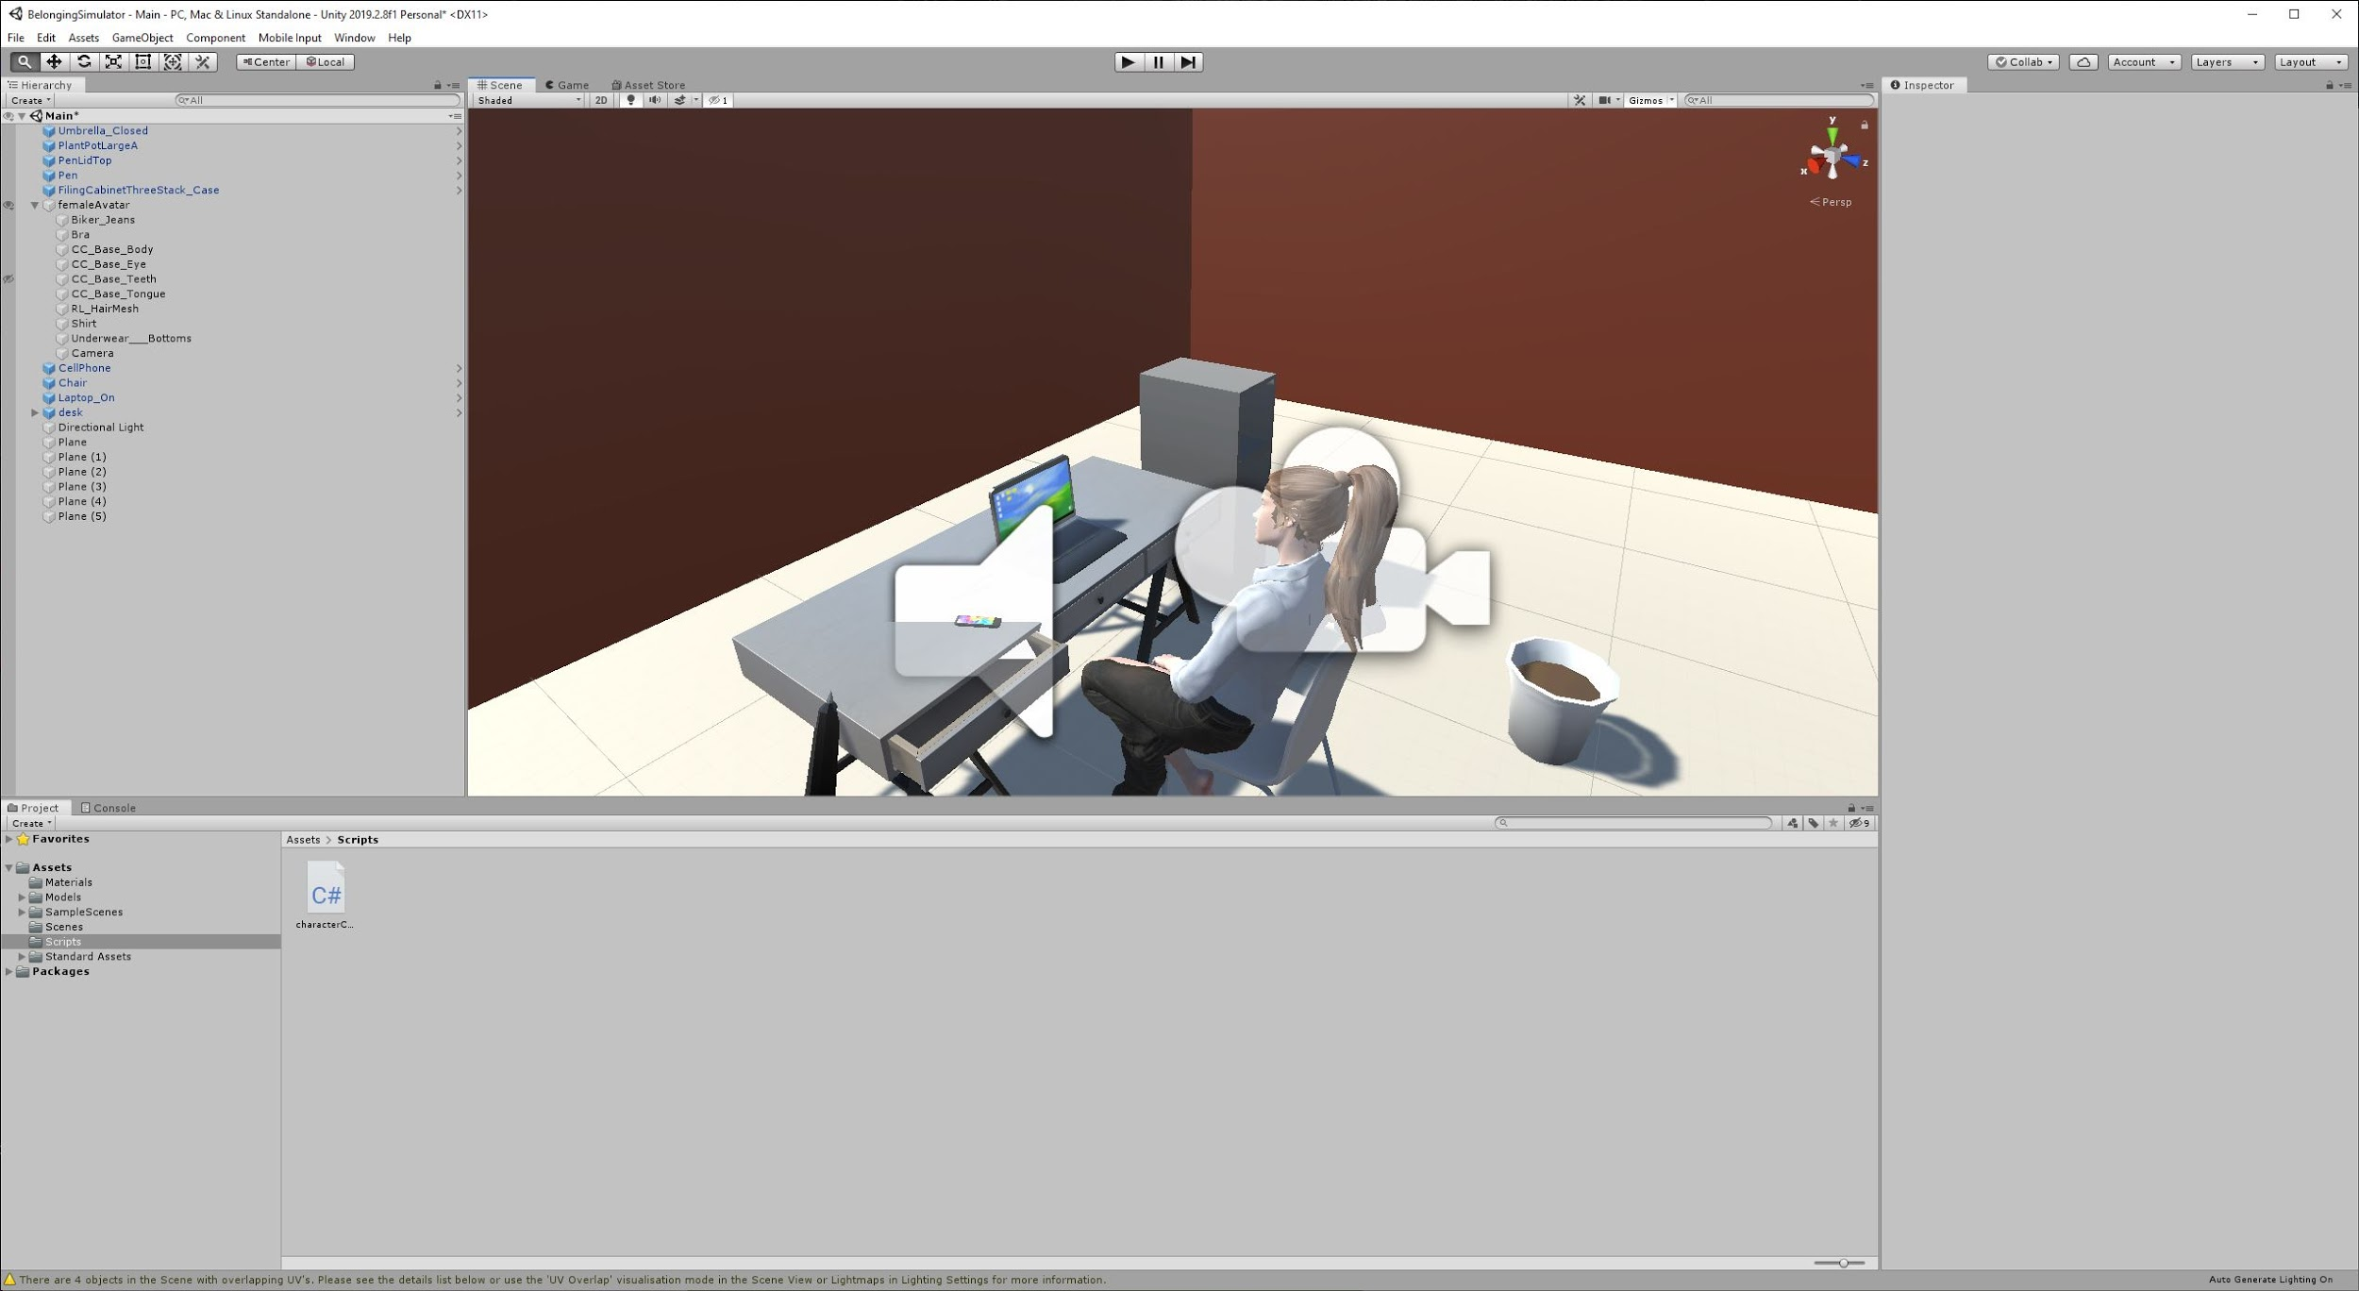

Slide 9
Introduction Draft
Find on GitHub

Slide 10
Current Progress: Future Expectations
Checkpoint 2:
Have the scene mapped out in Unity
Complete Introduction draft for final paper
Checkpoint 3:
Have a functional scene that collects necessary data and stores it effectively
Be using Oculus Rift in development process
Checkpoint 4:
Have working simulation done
Complete pilot testing
Checkpoint 5:
Complete experiment with all participants
Have full draft of research paper complete

